Slide 2
The Law and Health Care
Health Information Science 140
University of Victoria

Slide 3
Learning Objectives
8.1 Describe the health care legislation.
8.2 Explain the federal and provincial jurisdictional framework related to health care.
8.3 Outline the concerns about and the issues related to health care as a right.
8.4 Discuss the legality of offering private services in Canada.

Slide 4
Learning Objectives
8.5 Discuss the basic principles of consent to treatment.
8.6 Explain the health record related to privacy legislation.
8.7 Describe the role of regulated health professions in legal matters.
8.8 Identify some other important legal issues in Canadian health care.

Slide 5

Canadian Charter of Rights and Freedoms (first adopted in 1982)
Under the Constitution, everyone has the following fundamental freedoms:
Freedom of conscience and religion
Freedom of thought, belief, opinion, and expression, including freedom of the press and other media of communication
Freedom of peaceful assembly
Freedom of association

Slide 6

Statutory Law versus Regulatory Law
Statutory laws are the laws passed in Parliament (i.e., at the federal level) or in the provincial or territorial legislatures.
Regulatory law possesses the legally binding feature of an act; however, regulatory law is made by delegated persons or organizations, such as an administrative agency or a tribunal.
For example, the Food and Drugs Act oversees Health Canada’s Food and Drug Regulations
In health care, regulatory law affects hospital boards, health care institutions, and bodies governing health care professionals.

Slide 7

Common (Case) Law and Civil Law in Canada
Made by judges deciding cases
The legal system in all provinces and territories except Quebec is based on common law.
Common law, also called case law, results from judges’ decisions, which are based on precedents—rulings other judges made in previous similar cases.

Slide 8
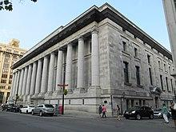
Quebec Law
Civil matters are regulated by French heritage civil law
Public law, criminal law and federal law operate according to Canadian common law.

Slide 9
Public and private law
Public law pertains to matters between and individual and society as a whole (criminal, tax, constitutional, human rights)
Private law matters concerning relationship between people or legal entities and includes property and contract law such as inheritance, family law and corporate law.

Slide 10
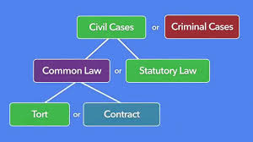
Tort Law
Tort law covers wrongful acts, intended or not, that result in harm or damage to another person or another person’s property.
Health care professionals may be accused of a tort if a patient experiences physical or emotional injury resulting from something the health care professional did, whether intentionally or unintentionally.
Unintentional torts may result from acts of outright negligence, misjudgment, or human error.

Slide 11

Negligence
Negligence, also referred to as malpractice, occurs when a health care professional fails to meet the standards of care of his or her profession.
Negligence can result from
Forgetting to perform an action
Not caring or confirming whether a particular action is performed
Intentionally or unintentionally providing improper or substandard care
Providing a patient with unclear instructions
Failing to successfully instruct a patient in how to follow a treatment plan

Slide 12

Negligence
Professional misconduct is behaviour or some act or omission that falls short of what would be proper in the circumstances, such as
Deviating from a profession’s standards of practice
Violating the boundaries of a professional–patient relationship

Slide 13
Who is Elizabeth Wettlaufer?
Elizabeth Wettlaufer murdered 8 elderly patients, yet her crimes went unnoticed for a decade.
The crimes began in 2007 and continued to 2016 when Wettlaufer finally confessed to police. Until then, her employers, police and Ontario's licensing body for nurses had no idea 8 patients had been murdered and 6 more poisoned —all with injections of massive doses of insulin.
Warning signs about the nurse's conduct were repeatedly ignored.
The public inquiry's first witness was the administrator at the Carressant Care long-term care facility in Woodstock, Ontario, where Wettlaufer since admitted to killing 7 of her 8 victims. She detailed at least nine separate occasions where Wettlaufer was suspended or admonished for making medication errors, abusing a patient and staff. It was revealed that the facility had increasing concerns about Wettlaufer, and in 2012 threatened to report her to the College of Nurses of Ontario for a "fitness to practise" hearing that could have put an end to her career. However, the facility didn't follow through at that time.
The College of Nurses of Ontario indicated that the facility had reported her termination to the licensing body in April 2014, shortly after she was fired, and was also provided with a list of her transgressions yet her licence was neither suspended nor revoked. She is now serving a life sentence.

Slide 14
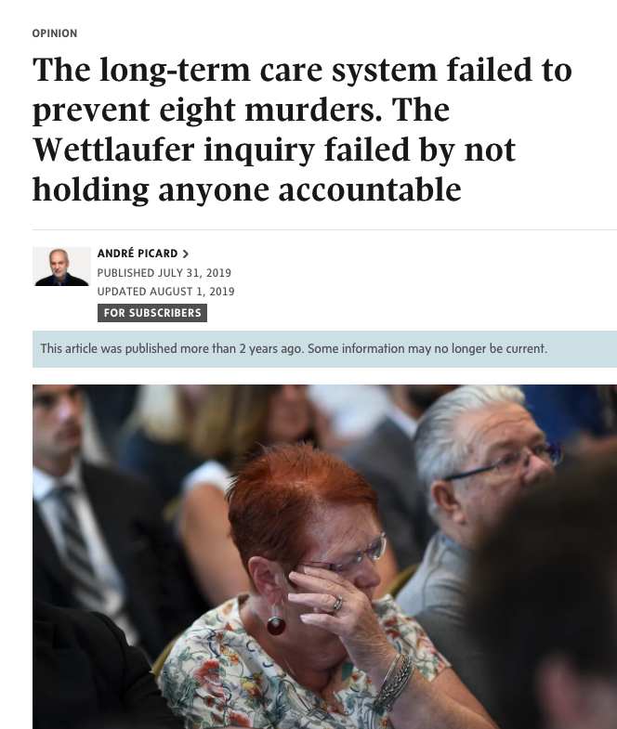
Wettlaufer inquiry
The inquiry made 91 recommendations on what needs to be done to prevent similar tragedies in the future, including:
Better training for administrators on how to screen, hire, manage and discipline staff;
Bolstering the medication-administration system in long-term care homes;
Expanding funding from the Ministry of Health and Long-Term Care;
Conducting a study to determine adequate staffing levels in long-term care homes.
Bolstering inspections, and giving priority to responding to “high-risk incidents” such as fatal medication errors;
More clear reporting requirements for service providers and staff, both to the ministry and regulatory colleges and more robust investigations;
Better death records, and more frequent autopsies of patients who die in long-term care;
Building awareness of the “health-care serial-killer phenomenon”

Slide 15
Who was Joyce Echaquan?
Joyce Echaquan was an Indigenous mother of seven who died in a Quebec hospital after filming, from her hospital bed, staff who were insulting her.
She was in clear distress and pleading for help.
Toward the end of the video, which was streamed live, two female hospital staff enter her room and are heard making degrading comments, including calling her stupid and saying she'd be better off dead.
Echaquan wasn't properly supervised on the morning of Sept. 28, 2020 — the day of her livestream — after she was given powerful sedatives. She went into cardiac arrest later that day and died from pulmonary edema, an excess of fluid in the lungs. She could have been saved if she'd been more closely monitored. She had serious health problems, including severe cardiomyopathy, which had been treated since 2014.
This is a tragic example of the systemic racism many Indigenous people face when accessing health services in Canada, advocates and patients say.
The video has created widespread indignation, several inquiries and a lawsuit from Echaquan's family against the hospital where she died in Joliette, Que.

Slide 16
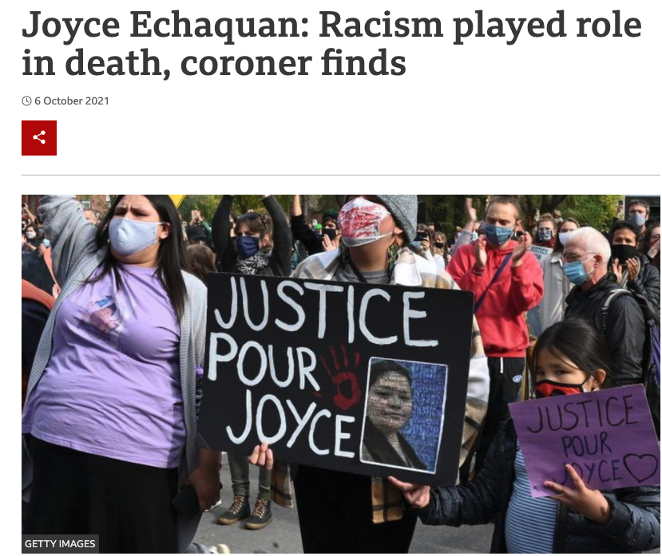
Joyce Echaquan's death highlights systemic racism in health care
Recommendations: For the Quebec government
-- Recognize the existence of systemic racism within our institutions and make a commitment to contribute to its elimination.

Slide 17
Recommendations
For the College des medecins du Quebec, the province's order of physicians
-- Review the quality of the medical care given by the doctor responsible for family medicine and by the medical resident in gastroenterology to Ms. Echaquan during her hospitalization in September 2020.
For the Ordre des infirmieres et infirmiers du Quebec, the province's nurses order
-- Examine the quality of care of nurses' services provided to Ms. Echaquan during her hospitalization.
-- Review the integration practices of college-level nursing candidates in emergency departments across hospitals in the province.
For the Department of Higher Education and its institutions that train doctors, nurses and nursing assistants
-- Include in the school curriculum training on the care of Indigenous patients that takes into consideration the realities of Indigenous communities.
-- Establish with Indigenous communities a greater offer of internships for both nurses and medical residents.
For the hospital in Joliette, Que., where Echaquan died
-- Ensure the effective integration of the Atikamekw liaison officer into the hospital, in particular by involving them with care teams.
-- Ensure notes in medical files reflect the reality of how patients are being cared for.
-- Review the nurses-to-orderlies ratio based on standards recognized at the provincial level in order to provide safe services to the population.
-- Maintain periodic training on the establishment's code of ethics, restraint measures, the monitoring of patients following a fall, and record management.
-- Quickly set up training and activities for the inclusion of Indigenous culture that is coordinated with the community of Manawan.
-- Improve the nurse/nursing assistant model and ensure that each has a clear understanding of their roles.
https://montreal.ctvnews.ca/read-the-list-coroner-s-recommendations-to-prevent-another-death-like-joyce-echaquan-s-1.5612652

Slide 18
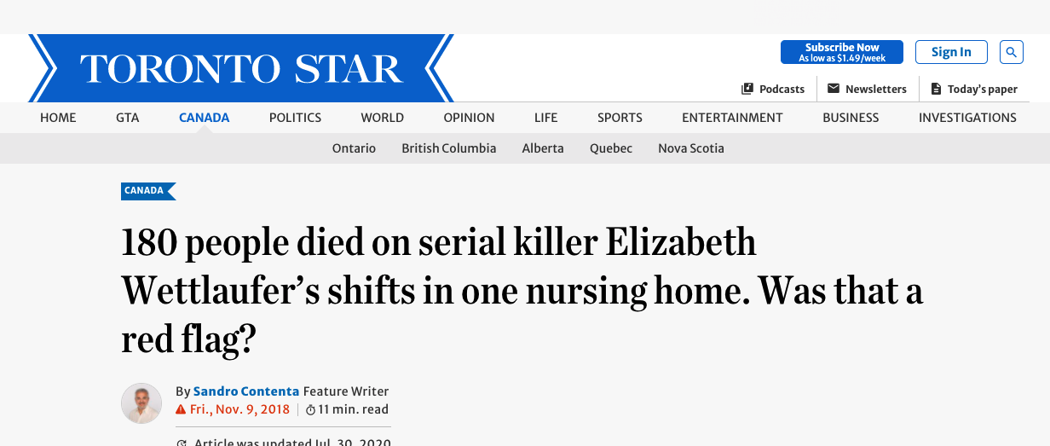
Other Types of Law
Contract law concerns legally binding contracts—voluntary agreements between two or more parties.
A breach of contract occurs when one of the parties fails to meet the terms of the agreement.
Criminal law deals with crimes against people and/or property and those deemed intolerable within society (e.g. murder, racism, theft).
A health care practitioner who willfully engages in a harmful act with the intent of harming his or her patient would be guilty of a crime.

Slide 19
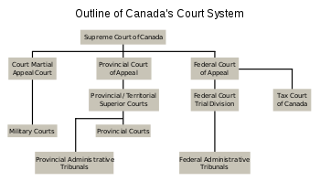
Federal and Provincial Jurisdictional Framework
Initially, the provinces assumed responsibility for “the establishment, maintenance, and management of hospitals, asylums, charities in and for the province, other than for marine hospitals.”
The federal government retained authority over
Health care for certain population groups
The provision of federal funds to the provinces and territories
Certain components of health care activity covered by the Criminal Code of Canada

Slide 20
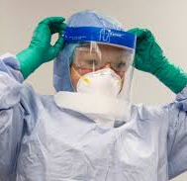
Occupational Health and Safety: Jurisdictions
The federal government manages labour affairs for
Employees of the federal government and of federal corporations
Individuals working in occupations that cross provincial and territorial lines
The federal public service sector
Each province and territory hosts an occupational health and safety agency, which enacts legislation for ensuring a safe workplace for all Canadians.
Workers’ Compensation Boards concentrate specifically on assisting injured employees by providing wages, rehabilitation, and training.

Slide 21
Drugs and the Law
Canada’s drug laws are covered primarily by federal legislation called the Controlled Drugs and Substances Act, which
Categorizes drugs based on their potential for harm
Outlines for hospitals and health care professionals
Who can prescribe controlled drugs
How to dispense and monitor controlled drugs in facilities
Controlled drugs can only be prescribed for legal, therapeutic purposes.
Surprise news statement (March 2023) in light of our challenging addictions crisis: Some drug companies have been licensed by Health Canada to produce and sell cocaine.

Slide 22
Opioid Crisis
Health Canada has called the continuing number of opioid related overdoses and deaths a national crisis.
It has sanctioned a number of initiatives to address the problem.
17,602 apparent opioid toxicity deaths between January 2016 and June 2020
1,628 apparent opioid toxicity deaths occurred between April and June 2020, representing the highest quarterly count since national surveillance began in 2016. This number also represents a 58% increase compared to January to March 2020 (1,029 deaths) and a 54% increase from the same time frame in 2019 (1,059 deaths).
In 2020 (January to June), 97% of apparent opioid toxicity deaths were accidental (unintentional).

Slide 23
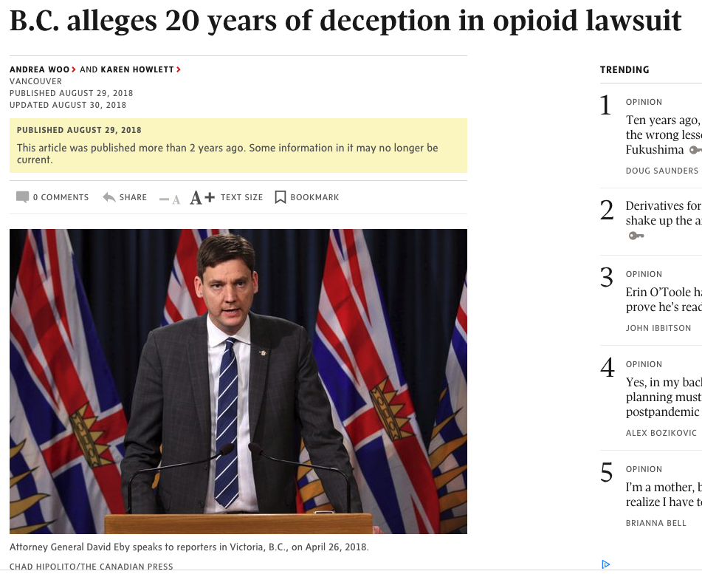
Litigation and the opioid crisis
On November 24, 2020, the manufacturers of OxyContin, Purdue Pharmaceuticals, settled on a guilty plea with United States (US) federal prosecutors for their role in the opioid epidemic.
They pled guilty to charges of conspiracy to defraud the US, violation of federal healthcare reimbursement laws, and sale of opioids to doctors they suspected of writing illegal prescriptions.
The guilty plea provides for over 8 billion USD in forfeitures, which could bring the company’s cost from opioid litigation to as much as 12 billion USD.

Slide 24
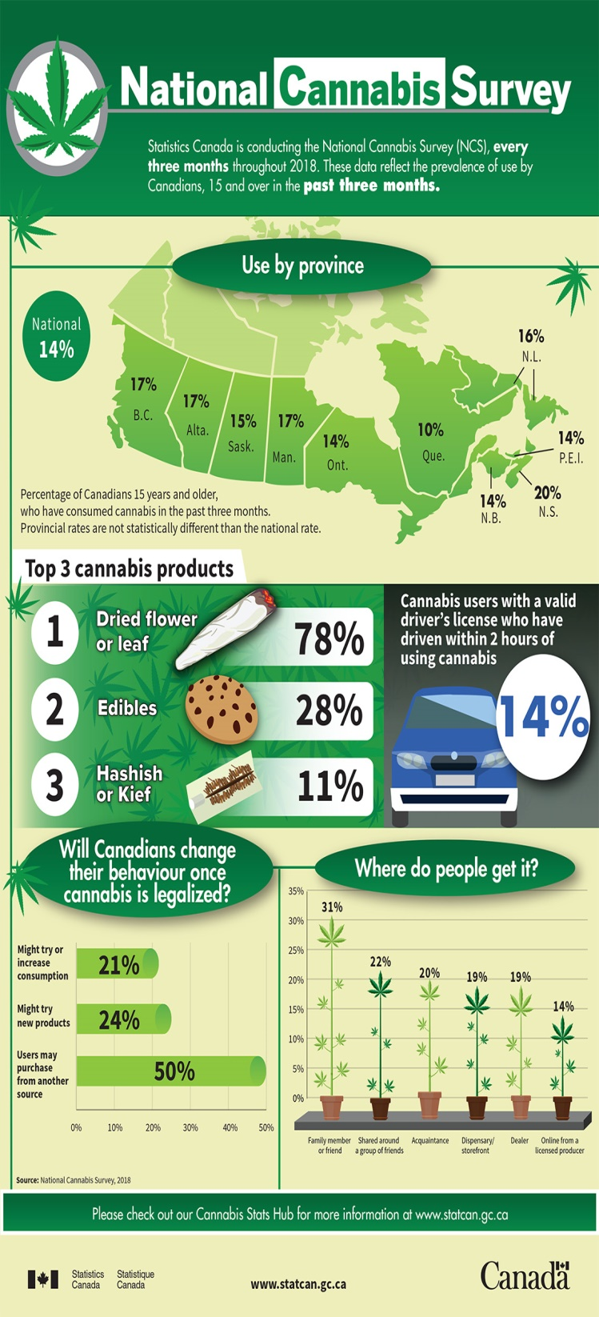
Cannabis (Marijuana)
The Cannabis Act (enacted in 2018) details the legal framework for the production, distribution, sale and possession of cannabis for recreational use.
Matters affecting the legislation are split between federal and provincial/territorial governments, and as a result differences in regulation occur among provinces and territories.

Slide 25
The Law and Health Care

Slide 26
Digital Health Canada- Free Membership for Health Information Science Students
Take advantage of the career development and learning opportunities Digital Health Canada offers, such as extensive networking and volunteer opportunities, discounts on event registration fees, free access to weekly members-only webinars, discounts on online courses, notification of new job postings, and opportunities to join working committees.
How to request your complimentary access to Digital Health Canada:
If you are a declared Health Information Science Student (HINF or Combined):
Send an email to aim@digitalhealthcanada.com to ask to be added to our School’s roster
You will then receive login and password information directly from Digital Health
To log in visit digitalhealthcanada.com

Slide 27

Bill C-77, the Emergencies Act
The Emergencies Act was designed to modernize Canada’s approach to national emergencies, balancing the maintenance of public order with the protection of civil liberties and calibrating the powers of the federal government with provincial jurisdiction and competencies. Bill C-77 also gave Parliament approval and oversight powers, upon the declaration of a national emergency and its duration (maximum of 90 days, subject to extension through a vote in Parliament) and for any associated orders or regulations invoked in responding to the emergency, which did not exist under the War Measures Act.

Slide 28

Health Care as a Right
Many Canadians regard health care as a fundamental right, even though it is not specifically identified in the Canadian Charter of Rights and Freedoms.
Health care is a legal right under the Canada Health Act, but this right is limited by conditions of the act, such as the concept of medically necessary services
Challenges relating to the right to health care often arise under sections 7 and 15 of the Charter.

Slide 29
Canadian Charter of Rights and Freedoms
Section 7 – life, liberty and security of persons
Persons rights violated?
Medical resources available at the time of the person’s illness
Demands made on those resources
Urgency of the individuals' medical needs
Chaoulli v. Quebec
Supreme Court of Canada ruled that Quebec's ban on private insurance violated freedom of choice and access.
Cambie Surgical v. BC
Justice Steeves held that the Plaintiffs had failed to demonstrate that the deprivation of the relevant section 7 right (security of person) was contrary to the principles of fundamental justice - specifically the principles against arbitrariness, overbreadth, and gross disproportionality
BC Supreme Court of Appeal
https://www.bccourts.ca/jdb-txt/sc/20/13/2020BCSC1310.htm

Slide 30

End-of-Life Issues
Advanced care directives are instructions prepared by a mentally competent individual outlining their wishes concerning health care decision in the event they can no longer decide for themselves.
Types: instructional and proxy.

Slide 31
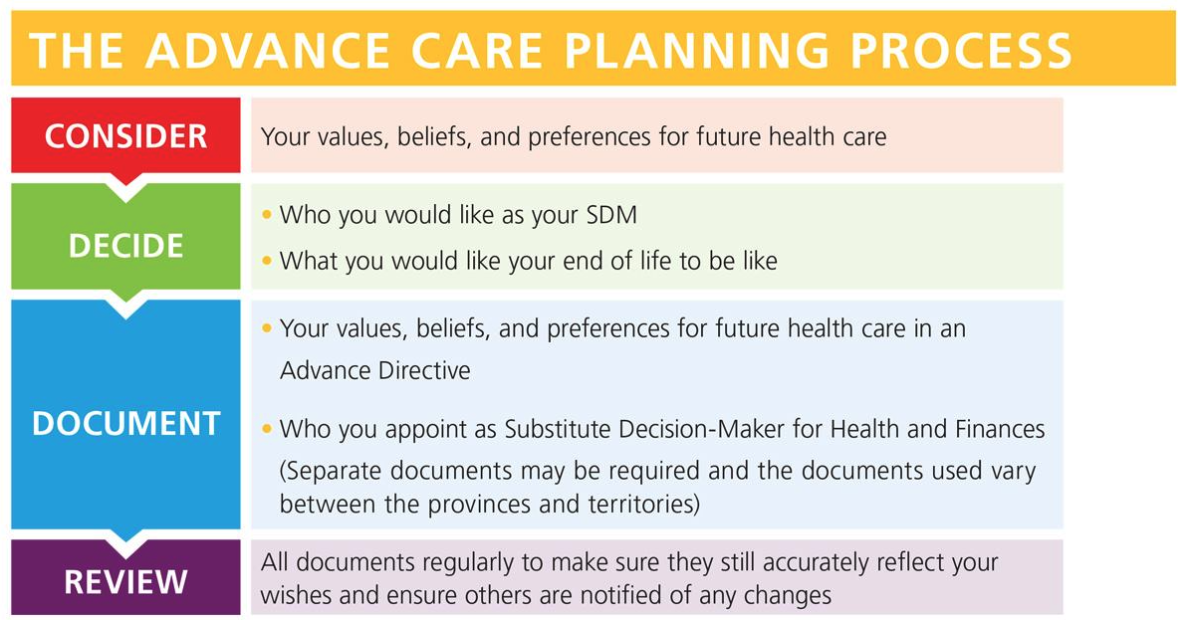
Advanced Care Directive
Instructional
Specific instructions detailed providing persons wishes clearly relative to presumed circumstances.
Proxy
General principles of instruction delegated gives the decision maker the latitude to make situational decisions.

Slide 32
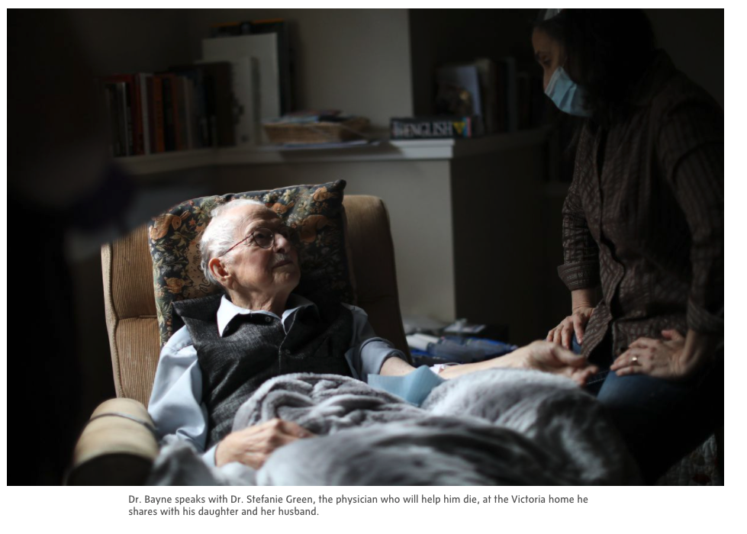
End-of-Life Issues
Medical Assistance in Dying (MAID) became legal in 2016
Health provider administers lethal medication, or
Health provider prescribes lethal medication that applicant can self-administer
Patient must meet all eligibility criteria
Sound mind at time of procedure
https://www.theglobeandmail.com/canada/article-why-did-a-geriatrician-who-fought-to-give-seniors-hope-seek-medically/

Slide 33
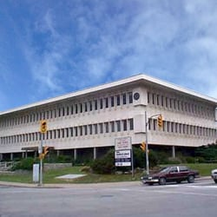
The Legality of Private Services in Canada
Canadians cannot buy insurance for, or access private health for medically necessary procedures.
All provincial and territorial governments fund certain types of medical/surgical care in private clinics under specified conditions.
Doctors may work in either a public or a private system or in both.
Independent health care facilities are private facilities (e.g. laboratories, physiotherapy centre).

Slide 34

Informed Consent to Treatment
In order to provide informed consent, a patient must understand, consent to, and accept the treatment and its foreseeable risks; the patient must also be made aware of the alternative choices available.
When doubt exists about a person’s capacity to understand the information provided, the health care professional must determine whether the person is capable of giving consent to treatment.

Slide 35

Elements of Informed Consent
Consent must be informed and voluntary
Informed: When a treatment is recommended, patients must understand
The treatment or procedure recommended
The risks, side effects, benefits, and expected outcomes
The implications of refusing
Alternatives to the proposed treatment
Voluntary: Patients must not feel
Compelled to make a decision for fear of criticism
Pressured toward any particular decision

Slide 36
Types of Consent
Express consent can be written or oral and indicates a clear choice on the part of the patient
Written consent is required for all major medical interventions. Most consent forms have to be signed by the patient, dated, and witnessed.
Oral consent is given by spoken word over the phone or in person and is equally binding.
Implied consent occurs by virtue of the fact that an individual seeks the care of a physician or other health care provider.

Slide 37
Who Can Give Consent
A competent person receiving the intervention most often gives consent for the treatment. If an individual is not capable, consent may be provided by the
Power of attorney or other legal representative
Next of kin, usually in a predetermined order
Age of majority for medical treatment consent is becoming irrelevant.
As long as the minor fully understands the treatment and its risks and benefits, health care professionals must respect his or her wishes.

Slide 38
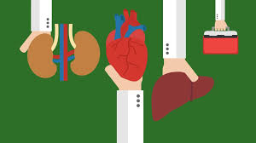
The Nova Scotia Human Organ and Tissue Donation Act
As of 18 January 2021, if you don't register your donation decision and you are eligible, you will be seen as having consented to organ and tissue donation after death. This is called ‘deemed consent’ under the new Human Organ and Tissue Donation Act.

Slide 39

The Health Record
The health record is an accumulation of information relating to a person’s interaction with health care services.
A health record in a hospital setting will have more components than one in a clinic setting.
Health care providers must, by law, record information concisely, clearly, and accurately.
All entries must be dated and signed or initialed.

Slide 40

Ownership of Health Information
The health care facility that collects the information and creates the health record owns the patient’s physical chart.
The health information itself, however, belongs to the patient.
Patients retain the right to request a copy of their information.
When a third party requests a patient’s health information, the patient must provide written consent for its release, or a court of law may order the release of such information.

Slide 41

Federal Legislation and Privacy Laws
Each of Canada’s provinces and territories implements its own privacy legislation.
Two related federal acts contribute to this protection:
The Privacy Act limits the private information federal government departments and agencies collect from individuals
The Personal Information Protection and Electronic Documents Act (PIPEDA) protects personal information preserved in the private sector
In most jurisdictions, personal information collected by health care facilities remains under the protection of province- or territory-generated, public-sector legislation.

Slide 42

Confidentiality
Health care professionals must legally and ethically keep all health information confidential.
Any health care professional involved directly in a patient’s case (i.e., the patient’s circle of care), legally has access to that patient’s information.
In the hospital setting, the circle of care may include
Doctors
Nurses
Social workers
Physiotherapists
Other members of the health care team
Administrative personnel

Slide 43

Electronic Health Information Requirements
Both electronic and hard copy records are subject to the principles of confidentiality and the protection of health information.
The electronic environment poses unique challenges to maintaining confidentiality and privacy standards.

Slide 44

Regulated Health Care Professionals
All regulated professions have a system in place for dealing with complaints against their members and for dealing with members charged with an offence.
Patients who have complaints against health care professionals may launch a legal complaint as well as a complaint to the related regulatory organization.
Every profession has a code of ethics that provides moral and ethical guidelines.

Slide 45

Health and The Arts

Slide 46
Arts and health
Oxford textbook of creative arts, health and well-being: International perspectives on practice, policy, and research. Clift & Camic (2016). Oxford University Press.
The idea that creative arts have a direct role in the care of people living with illness, and promoting recovery, has a long history - from classical times of Plato and Aristotle in ancient Greece to recent BBC Reith Lectures in the UK.
However, it is only since the beginning of the 20th century that the arts have been seriously viewed as therapeutic in health care interventions, especially on psychological levels.
The development of arts in health practice for community well-being and health promotion is more recent, increasing in momentum over the last sixty years.
Arts & Health: An International Journal for Research, Policy and Practice (Editor, Ross Prior) first appeared in 2010.

Slide 47
Arts and health
We are currently seeing increased recognition in the training of medical and health care professionals.
For example, Dalhousie University medical students must complete a full arts program integrated as part of their education.
Research has shown that arts education improves empathy and communication for physicians.
Growth of regional arts-for-health organizations has increased, particularly in English-speaking countries (Australia, Canada, New Zealand, the UK and US) and across Europe and Scandinavia along with Israel, Uganda and other countries.

Slide 48
Arts & health – principal networks
Arts and Health Australia (http://www.artsandhealth.org/about-us.html)
Was established to enhance and improve health and wellbeing within the community through engagement in creative activities.
Provides guidance on research and strategic development, hosts conferences and provides training. Covers primary and acute care, aged care, community health and health promotion.
Advocates arts and health practice in primary care and community health.
Demonstrates the effectiveness of the arts in health promotion.
Showcases the value of the humanities in medical education and the wellbeing of clinicians and healthcare professionals.
Networks with people working in healthcare, arts, education, and the community.
Connects with international counterparts on development in practice and research.
Facilitates policy change at all levels of government to stimulate the growth of arts and health initiatives.
Supports scientific research and evaluation of arts and health programmes.

Slide 49
Arts & health – principal networks
Global Alliance for Arts and Health (United States)
Formerly known as the Society for the Arts in healthcare, was a not-for-profit organization based in Washington, DC until 2014. It was the largest and one of the most long-standing arts and health organizations internationally. Its focus was on practice development, supporting policy initiatives, and training, and sponsored the journal, Arts & Health.
Objectives of the Alliance:
Demonstrate the roles the arts can play in enhancing the healing process.
Advocate for the integration of the arts into the environment and delivery of care within healthcare facilities.
Assist in professional development and management of arts programming for healthcare populations.
Provide resources and education to healthcare and arts professionals.
Encourage research on the beneficial effects of the arts in healthcare.

Slide 50
Arts & health – principal networks
National Alliance for Arts, Health and Wellbeing (England) (http://www.artshealthandwellbeing.org.uk)
Was established in 2012 with the support of Arts Council England. Brings together regional arts for health organizations across England. The Alliance has developed a Charter for Arts, Health and Wellbeing, and their website profiles current practice and research in England.
Objectives:
Provide a focused voice to articulate the role that creativity can play in health and wellbeing.
Offers a repository for arts and health practice and research.
Advocates on behalf of the arts and health sector to policy-makers in central and local government.
Encourages the use of the arts by health and social care providers.
Aspires to raise standards in drawing on the creative arts in the healthcare sector.

Slide 51
Arts & health – principal networks
Arts Health Network Canada (http://www.artshealthnetwork.ca)
The aim is to increase public awareness, understanding, and appreciation of the contributions of arts-based initiatives to individual and community health, as well as to Canada’s public healthcare system.
Bring arts and health activities into the mainstream, integrated in the fabric of communities and healthcare services so that the arts and cultural activities are embraced as integral in meeting the health and social needs of Canadians.
Engages arts/health users, organizations, decision-makers, and the broader public to understand and support the connections between health and arts-based activities.
Supports connection, dialogue and information-sharing through a comprehensive knowledge repository on arts and health in Canada.
Encourages the development of local and provincial networks of individuals and organizations interested and working in arts and health.
Collaborates with researchers and the community to assess the effectiveness of arts-based health initiatives.
Draws on experiences and research conducted in Canada and around the world to expand knowledge about effective arts and health programmes and practices.

Slide 52

Impact of Arts-in-Health
Growing international and Canadian research suggests that active participation in arts has significant benefits – examples include reduced use of pharmaceuticals, eases tension and fear in medical treatment, manages pain and chronic health conditions, reduces stress, improves communications, reduces doctor visits and decreases recovery time from surgery.

Slide 53
Arts & health – research reports on impacts
State of Arts-in-Health: Reports
Broadly speaking, arts-in-health programming globally has been growing exponentially, particularly in the U.K. (e.g., Cayton, 2006), Australia (e.g., McAdam, 2012) and the U.S. (e.g., Cohen, 2006).
Over fifteen years ago, nearly 400 papers had already been cited on the value of creative arts in healthcare Staricoff, 2004), and the UK Department of Health, Arts and Health Working Group had reviewed over 1,000 studies making a case for arts-in-health investments (Department of Health, 2006).
Research evidence of benefits of arts-in-health programming has been amassing for some time: “Arts and health initiatives are delivering real and measurable benefits across a wide range of priority areas for health… There is a wealth of good practice and a substantial evidence base” (Cayton, 2006, p. 3).
McAdam (2012) commented that arts-in-health research studies support an evidence-based argument for greater use of the creative expressive arts in healthcare as well as in the overall community, with an overall positive impact of the arts on health and well-being.
For a review of international perspectives on practice, policy and research on the creative arts as related to health and well-being, integrating works from China, South Africa, India, Brazil and Venezuela see Clift and Camic, 2016.

Slide 54
Arts & health – research reports on impacts
State of Arts-in-Health: Reports
As for Canada, Cox et al. (2010) concluded that the nation’s status was dramatically behind that of U.K., U.S.A. and other Western countries, and highlighted the challenges of little recognition, working in isolation and lack of funding.
In 2013, the Arts Health Network Canada and British Columbia affiliate were formed. Its aims are to support ‘arts & health’ as “a growing interdisciplinary field that embraces many forms of art to promote health and prevent disease in individuals and communities, enhance health service delivery and enrich research inquiry” (Arts Health Network Canada, 2013).
Arts Health BC is a not for profit organization focusing on “participation and engagement in the arts as a path to improved health, healing and wellbeing for all British Columbians… promotes the field of Arts & Health through outreach and education, engagement, collaboration & professional development” (Arts Health BC, 2016).
For a synthesis of the state of arts and health developments in various countries see: Clift et al., 2009 (England); Cox et al., 2010 (Canada); Cuypers et al., 2011 (Norway & Sweden); Goodman & Sims, 2009 (U.S.); and Wreford, 2010 (Australia).

Slide 55
Arts & health – research reports on impacts
State of Arts-in-Health: Reports – Synopses from a few examples:
UK: The State of the arts and health in England (Clift et al., 2009). Over 1,000 studies across multiple sites and contexts over time; key findings: arts & health care initiatives were delivering real measureable benefits across a wide range of priority areas for health.
Australia: The state of the arts ad health in Australia (Wreford, 2010). Impact of community-based arts programs on health – in hospitals, cancer care, surgery, mental health, staff outcomes; examined successful and failed programs; key elements of successful programs: decreased isolation and improved mental health for those in care.
US: State of the field report: Arts in healthcare 2009 (Goodman & Sims, 2009).
Emphasis on developing a strategic plan to raise awareness and promote arts in health care, to better document and disseminate research that demonstrates its value.
Evidence-based research found benefits in diverse sites and included music, visual arts, dance, literature, creative writing & storytelling, & drama among other areas. Also addressed methods used to measure benefits.

Slide 56
Arts & health – developments in the United States
Arts in health as a discipline of research and practice began to emerge in the United States in the 1980s.
The field integrates professional artists into healthcare settings to provide performances; creative engagement opportunities for patients, families and caregivers; and aesthetic enhancement to those environments.
Arts in health has become visible over the last forty years, recognized as both as a professional practice field and as an academic discipline.
In the US, arts programs have been established at about half of accredited healthcare institutions.
Arts-in-health also brings health promotion initiatives into communities, elevating equity and wellbeing supports.
Epidemiological studies in the 2000s have demonstrated that engagement in arts enhances immune function, longevity, well-being, improves community capacity and social cohesion, enhances public health promotion, mobilizes social change through promoting communications across groups, influencing policy and practice in community and economic development [Center for Arts in Medicine | College of the Arts | University of Florida (ufl.edu)]

Slide 57
Arts & health – developments in Canada
Arts and culture in medicine and health: A survey research paper (Cooley, 2003).
A seminal Canadian survey paper on arts in health care.
Concludes that 7 of 12 key determinants of health as defined by Health Canada have had significant contributions from arts in health initiatives: Examples – reduction of anxiety and pain; increased speed of medical intervention; reduced stress among nurses, physicians and caregivers; improvements in physical environments for patients and families. Many benefits of arts in health programs are cited.
While many arts genres are included in the survey, some are not (e.g., applied theatre and reminiscence theatre).
Cooley’s group continues to actively promote national networking and infrastructure development for arts in health. We now have a BC and Canadian Arts-in-Health Network.
Tipping the iceberg? The state of the arts and health in Canada (Cox et al., 2010).
Emphasizes the early stages of Canadian development of arts in health initiatives relative to the UK, Australia and US.
Solid research and increasing awareness of benefits are apparent.
The report concludes with a focus on needs for developing funding and infrastructure support, networking and communication on a national level, and interdisciplinary integration in arts and health care.
Arts Health Network Canada (2013). The report asserts the need for developing a funding infrastructure; in early stages of development. Now has an Arts in Health Society

Slide 58
Arts & health – developments in Canada
Nova Scotia: In 2005, the first Arts and Health Forum was held at Dalhousie University, which was the first medical school in the country to create a humanities programme, Healing and Education through Arts and Life Skills, including Narrative Medicine.
Prince Edward Island: 65 scholars’ research links between singing and community well-being.
Quebec: In Montreal, through Concordia University arts education to hospitals; offers M.A. in creative arts therapies.
Ontario: Toronto Conservatory of Music – arts-driven programmes to schools for mental health.
Manitoba: Artists in Health Care for Cancer.
Saskatchewan: Commonwealth Community Arts to promote cultural diversity.
Alberta: Hospital bedside programmes.
BC: Arts and health activities through community arts development programmes; Canada and BC Arts Councils; Vancouver’s Arts Way provides 2,500 live music programmes across BC.
Physicians and the arts: growing connections between arts and healing for patients and their well-being.
However, we do NOT have a fiscal infrastructure to support arts-in-health despite the global evidence-base.

Slide 59
Arts & health – Global synthesis of research evidence base
The most significant report to date, on global research evidence supporting arts in health: Health evidence network synthesis report 67: What is the evidence on the role of the arts in improving health and well-being? A scoping review. World Health Organization (Fancourt & Finn, 2019).
Global research through the World Health Organization (WHO) provides strong empirical support for evidence on the positive impacts of engagement in the arts for health and well-being.
Over the past two decades there has been increasing global research into the effectiveness of arts on health and well-being along with policy and practice developments.
The report synthesizes global evidence on the role of arts in improving health and well-being.
Results from over 3,000 studies identified a major role for the arts in:
Prevention of ill health
Promotion of health
Management and treatment of illness across the life span
Evidence from diverse disciplines was gathered from uncontrolled pilot studies, case studies, small-scale cross sectional surveys, nationally representative longitudinal cohort studies, community-wide ethnographies, and randomized control groups.

Slide 60
Arts & health – Global synthesis of research evidence
Key Findings
Because of a lack of awareness or evidence surrounding arts in health, there has been little consistency in policy development. This report aimed to close the awareness gap by mapping the current available evidence in the field study based on this research question: “What is the evidence on the role of the arts in improving health and well-being?”
Overall findings demonstrated that the arts can potentially impact both mental and physical health. Results clustered under 2 themes: Prevention and promotion.
Contributions of the arts in prevention and promotion:
Can affect the social determinants of health
Support child development
Encourage health-promoting behaviours
Help prevent ill health
Support caregiving
Contributions of the arts within management and treatment
Can help people experience mental illness
Support people with neurodevelopmental and neurological disorders
Assist with management of non-communicable diseases
Support end-of-life care

Slide 61
Arts & health – Global synthesis of research evidence
Policy Considerations
A number of considerations can be derived from the evidence mapped in this report; these target both the cultural and the health and social care sectors.
Acknowledge the growing evidence base for the role of the arts in improving health and well-being by:
Supporting the implementation of arts interventions where a substantial evidence base exists, such as the use of recorded music for patients prior to surgery, arts for patients with dementia and community arts programmes for mental health;
Sharing knowledge and practice of arts interventions that countries have found effective in their context to promote health, improve health behaviours or address health inequalities and inequities; and
Supporting research in the arts and health, particularly focusing on policy-relevant areas such as studies that examine interventions scaled up to larger populations, or studies that explore the feasibility, acceptability and suitability of new arts interventions.

Slide 62
Arts & health – Global synthesis of research evidence
Policy Considerations
Recognize the added health value of engagement with the arts by:
Ensuring that culturally diverse forms of art are available ad accessible to a range of different groups across the life-course, especially those from disadvantaged minorities;
Encouraging arts and cultural organizations to make health and well-being and integral and strategic part of their work;
Actively promoting public awareness of the potential benefits of arts engagement for health; and
Developing interventions that encourage arts engagement to support healthy lifestyles.
Note the cross-sectoral nature of the arts and health field through:
Strengthening structures and mechanisms for collaboration between the culture, social care and health sectors, such as introducing programmes that are co-financed by different budgets;
Considering the introduction, or strengthening, of lines of referral from health and social care to arts programmes, for example through the use of social prescribing schemes; and
Supporting the inclusion of arts and humanities education within the training of health-care professionals to improve their clinical, personal and communication skills.

Slide 63
Arts & health – Global synthesis of research evidence
Conclusion:
Given the size of the evidence, the report raises a number of policy considerations to support the development of long term policies and strategies to provide more collaborations between arts and health sectors.

Slide 64
The arts in public health policy: progress and opportunities
[From Dow, Warran, Letrondo, & Fancourt (2023)]
With growing evidence indicating the role the arts play in promoting good health and preventing and managing illness:
Call for inter-sectorial approach across policy development to address public health and health promotion issues.
Promote strong connections across different government offices (health, arts & culture, etc.)
Examples:
Finnish government: ‘Wellbeing, Health and Promoting Security 2030’ – commitments to increase the use of art activities in rehabilitation through greater cooperation between social and health care, nutrition, exercise, and cultural professionals.
Arts Council of Wales 2018: proposals to increase funding for arts activities that promote prevention, wellbeing, and recovery for mental ill health.
Ethiopia’s Mental Health Strategy – recognition that a multi-sectorial approach that includes the Ministry for Culture is needed to address poor mental health.

Slide 65
Examples of local arts-in-health initiatives
Youth mental health performance study
Research on the benefits of reminiscence and life review for older adults in care
Older adult driving study (‘No particular place to go’)
Voices in Motion

Slide 66
Arts and youth mental health
Studies have shown that coming together as a group to actively engage in the collective creative process is beneficial for mental health. It provides an opportunity to freely express views, giving voice and validation of experiences without fear of judgment.
Ongoing research study (SSHRC): Youth mental health performance: How young people respond to portrayals of mental health, resilience and well-being in and through drama and performance creation.
This is a large-scale research project implemented in 4 Canadian sites: Victoria, Coquitlam, Toronto, and North Battleford.
The study brought together secondary school students to engage in theatre play analysis and to devise and perform their original theatre performance reflecting their views on mental health.
Workshops explored portrayal of youth mental health in selected plays, as to whether these were realistic portrayals of the participants’ experiences and perceptions.

Slide 67
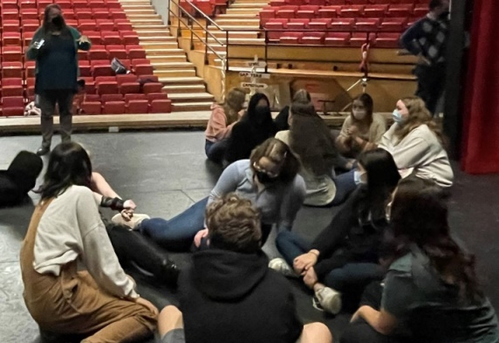
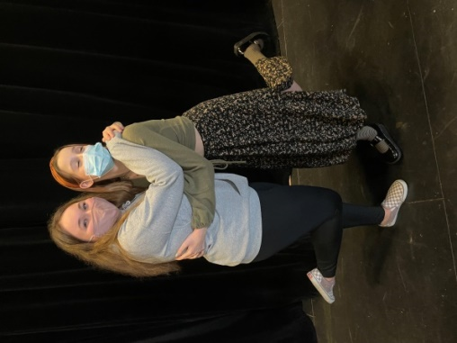
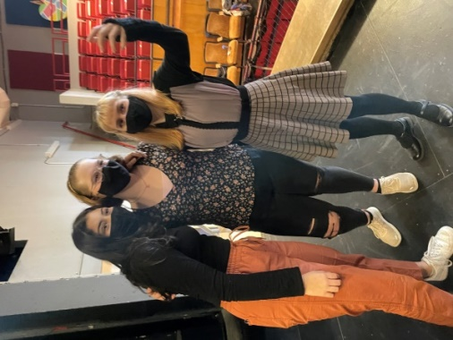
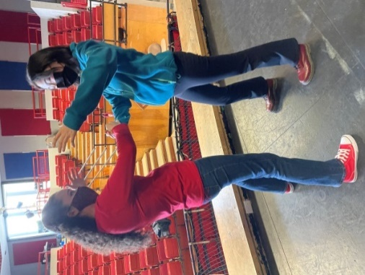
Students decided to create their scenes around the broad topics of safety, stress, depression, anxiety, insecurity and impact of the pandemic-induced isolation. The themes generated by the students directly aligned with mental health themes noted in the literature.

Slide 68
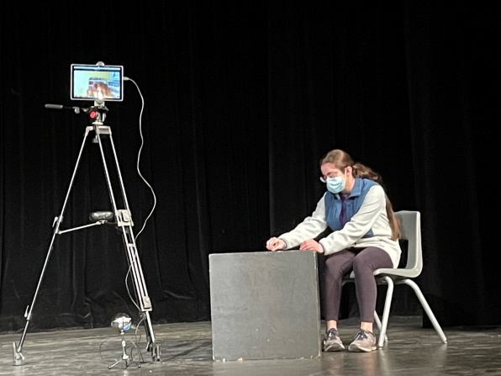
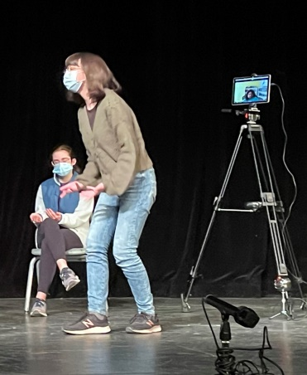
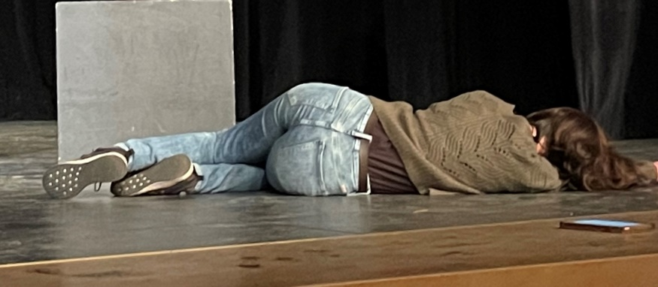
Student in front, playing
character of anxiety
Defeating anxiety, at climax of scene

Slide 69
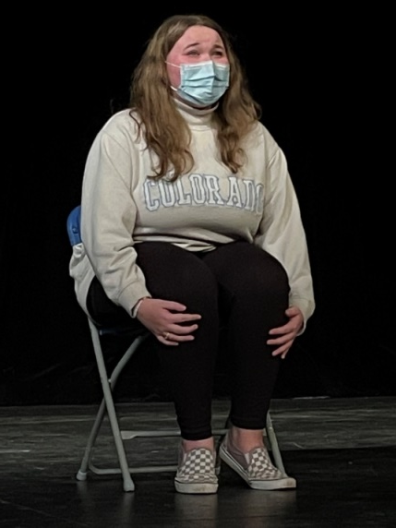
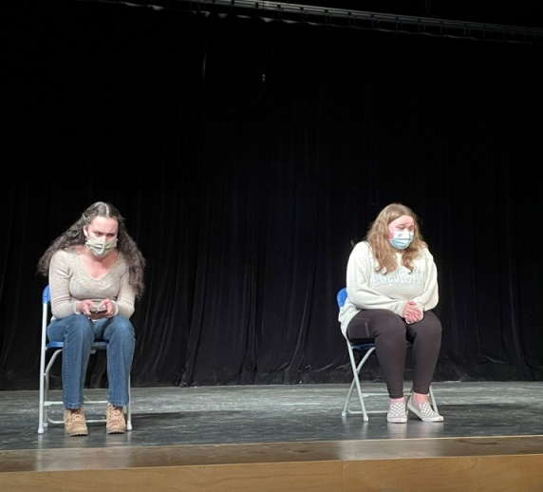
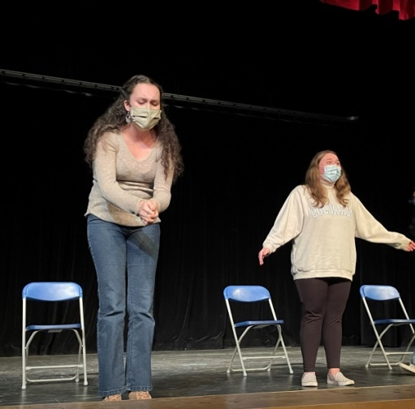
Two friends are visiting school. One reveals she’s being bullied. The secret is shared amongst friends.
Hiding in a washroom stall

Slide 70
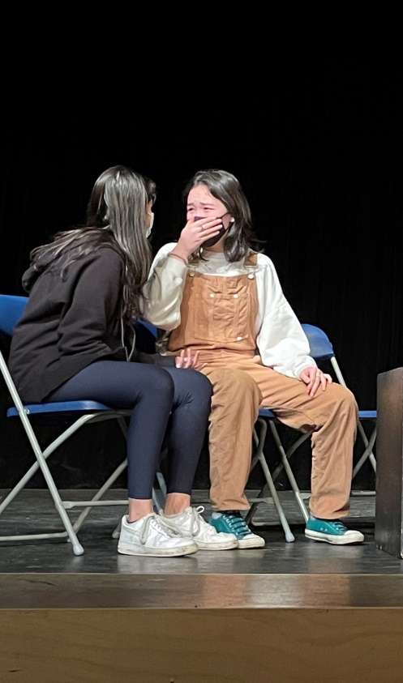
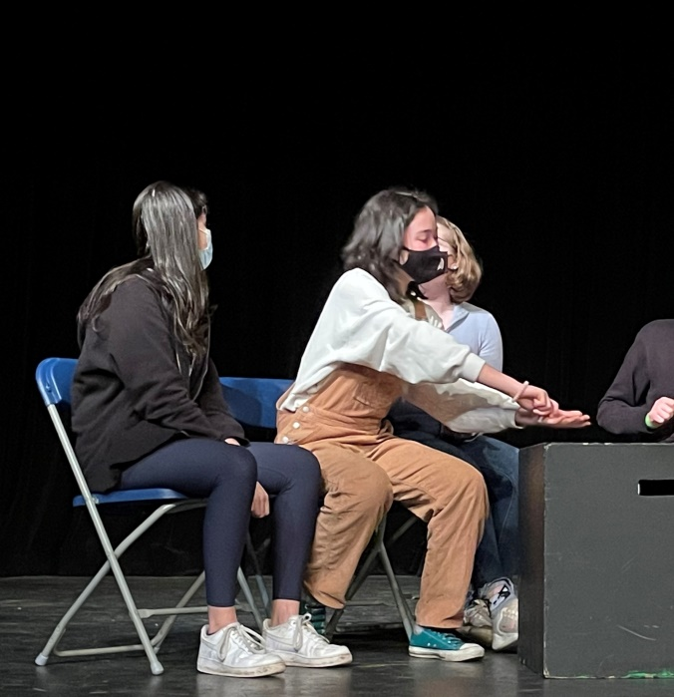
Family dinner When the truth is told

Slide 71
Benefits of reminiscence and life review for older adults in care
This study brought together older adults with mild to moderate dementia in residential care with UVic Theatre students over a 3-year period, with pre- and post-measures.
Life history interviews were recorded and transcribed verbatim.
Through a series of intergenerational drama improvisations and story-making workshops, a fictionalized theatre production based on the participants’ stories and experiences was created, entitled ‘The Artist and her Daughter’, and performed for an invited audience.
The study was based on seminal theoretical underpinnings that life review is an essential part of the healthy aging process in later life.

Slide 72

Moving forward backwards: Exploring the impact of active engagement in reminiscence theatre with older adults in residential care with mild to moderate cognitive impairment.
Trudy Pauluth-Penner, 2018
University of Victoria
Notes:
I acknowledge with respect the Lkwungen-speaking peoples on whose traditional territory the university stands and the Songhees, Esquimalt and WSÁNEĆ peoples whose historical relationships with the land continue to this day.
Thank you to the Committee: Co-supervisors Dr. Holly Tuokko (Psychology) and Dr. Warwick Dobson (Applied Theatre); Dr. Michael Hayes (Social Dimensions of Health); and External Examiner – David Barnet.
I wish to express a heart-felt thank-you to all who have come before and paved the way. I am immensely grateful to all who have supported and guided my educational path.

Slide 73
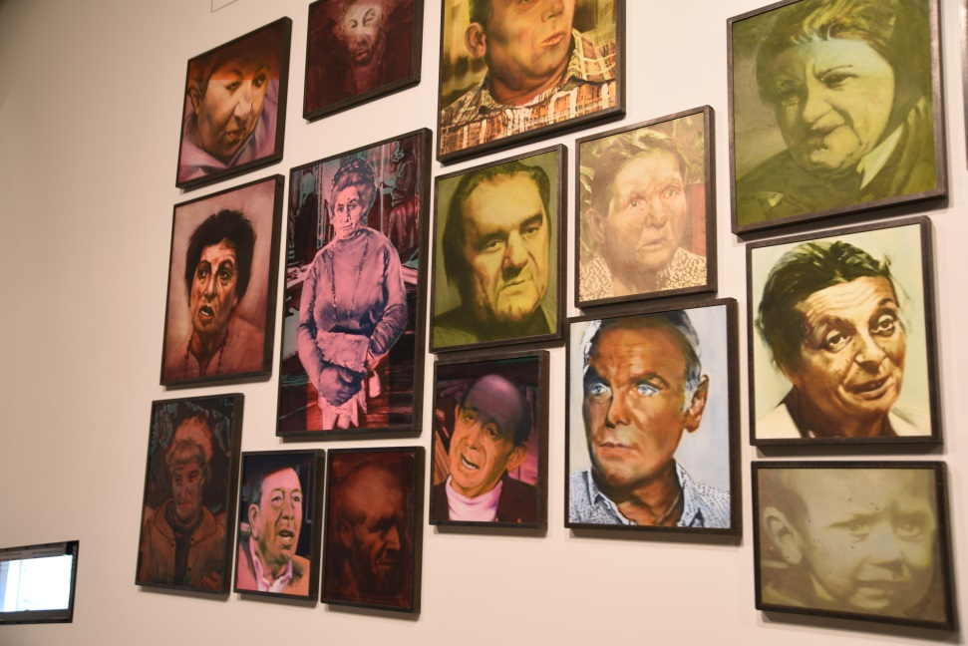
The Narrative Context
Narrative Gerontology
Narrative gerontologists explore “how aging individuals give meaning to their lives by studying how they ‘story’ their lives” (Bohlmeijer, Westerhof, Randall, Tromp, & Kenyon, 2011, p. xv).
Narrative gerontologists assert that memory and storying later life play a vital role in transforming theory, research and practice in healthcare by balancing biographical and biological understanding of the human and social experience (Birren, 2011).

Slide 74
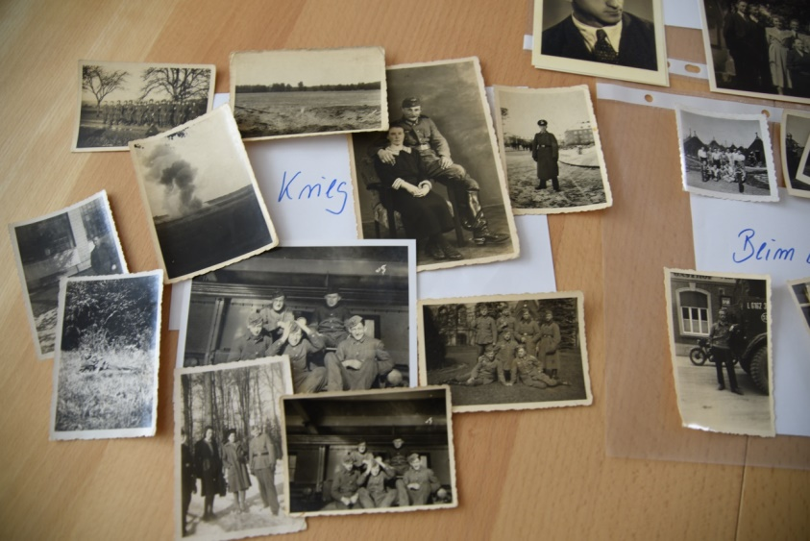
Interventional Narratology
This is a new term that has emerged from the medical narrative approach (Wood, 2005).
Interventional narratology encompasses a blend of medical narrative, storying later life, reminiscence, and psychosocial ethics.
It emphasizes the inclusion of human story and narrative as a vital component to foster understanding of human experience (Kenyon, Bohlmeijer, & Randall, 2011), and lies at the core of this reminiscence theatre study.
This emerging field encapsulates and connects the multiple disciplines that are pertinent to this study (gerontology, psychology, sociology, social dimensions of health, ethno-drama/theatre, narrative inquiry, applied theatre, and performance- and arts-based research).

Slide 75
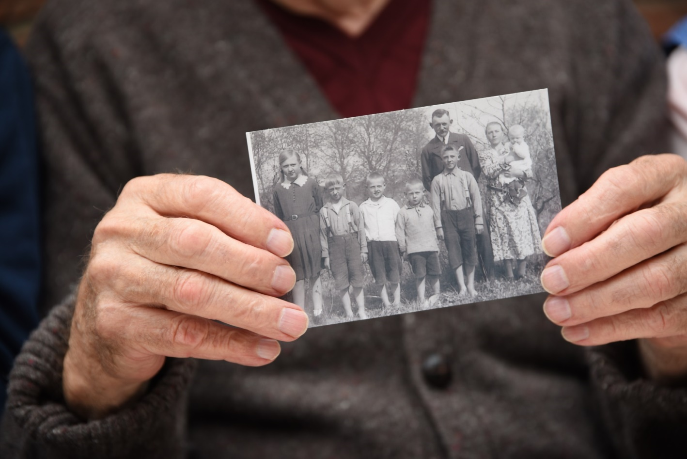
Reminiscence
Reminiscence is defined as the act or process of recalling the past with the added property of reaching out to infuse others with these memories.
Robert Butler in his seminal 1963 article asserted that reminiscence is essential for healthy adaptation through older adulthood.

Slide 76
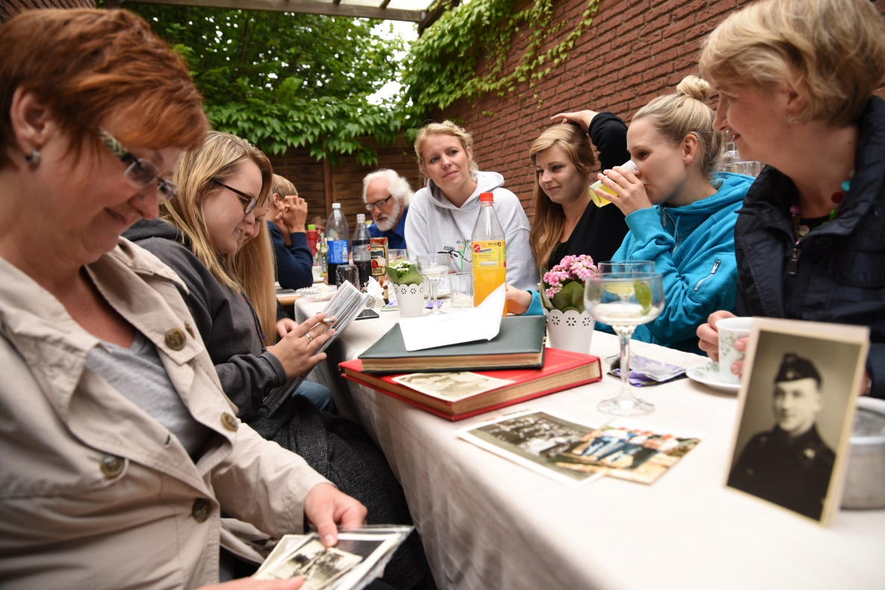
Life Review
Life review, somewhat different than reminiscence but equally important to seniors’ psychological well-being (Birren, 2011) is the process of recalling personally significant events from the past in order to make sense of the present.
It is “a naturally occurring, universal mental process characterized by the progressive return to consciousness of past experiences” (Butler, 1963, p. 66).
Tromp (2011) currently refers to the deliberate process of life review as “reminiscence… structured reflection on one’s entire life course” (p. 254).

Slide 77
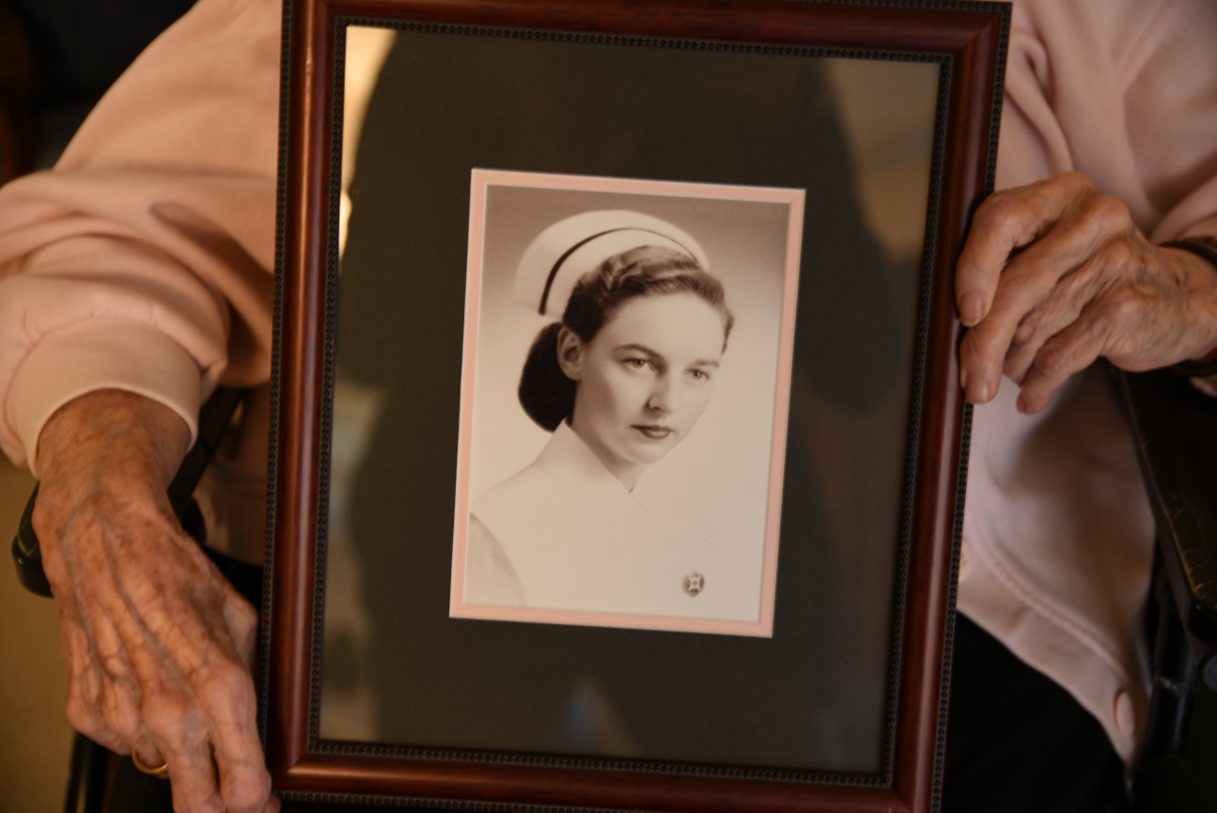

Slide 78
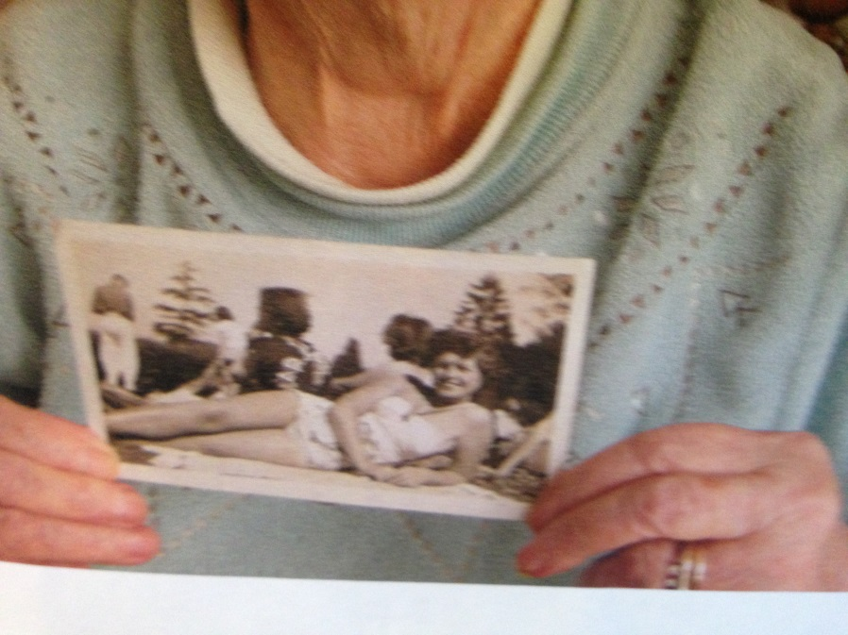

Slide 79
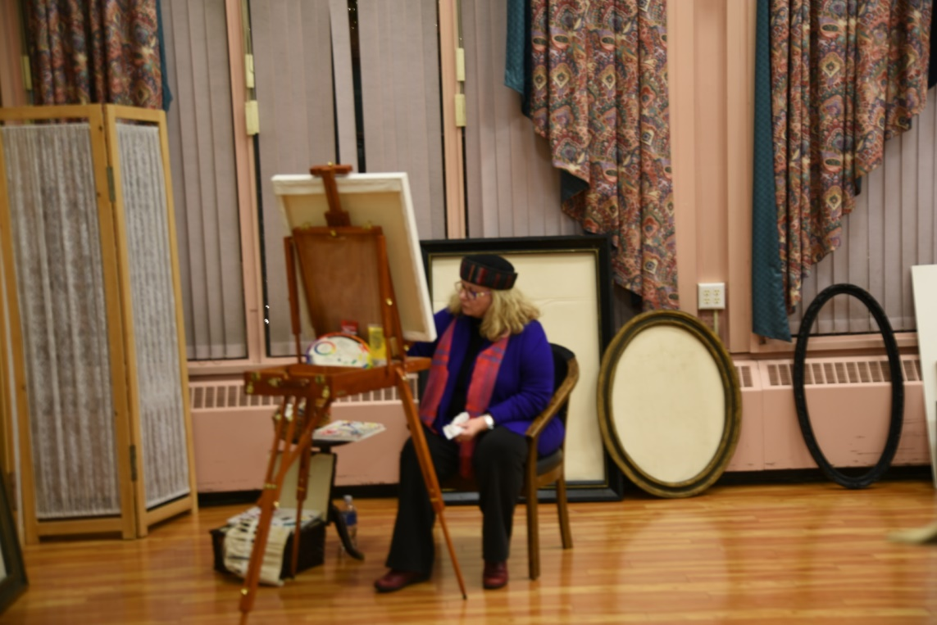
Stage 7: The Performance of ‘The Artist and her Daughter’
The play was performed at the residential care facility on December 4, 2015 for the older adult participants, their family members, facility staff and an invited audience of community and applied theatre artists with approximately 80 in attendance.
There was a post-performance social with music and refreshments, and post-production surveys were implemented during this time.
The production was video-recorded for archival purposes and to present to study participants and their families as a keepsake, along with a story booklet and project participation certificate.

Slide 80
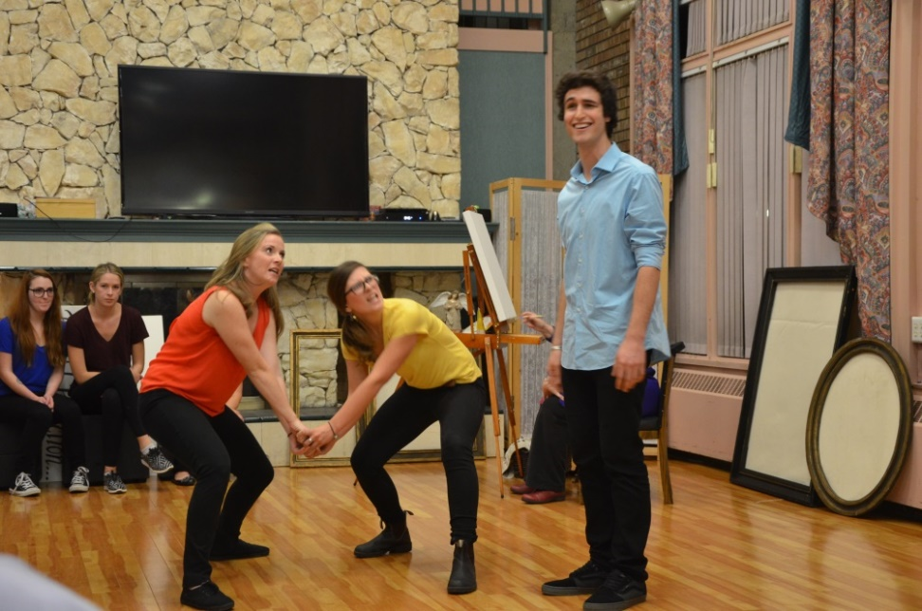
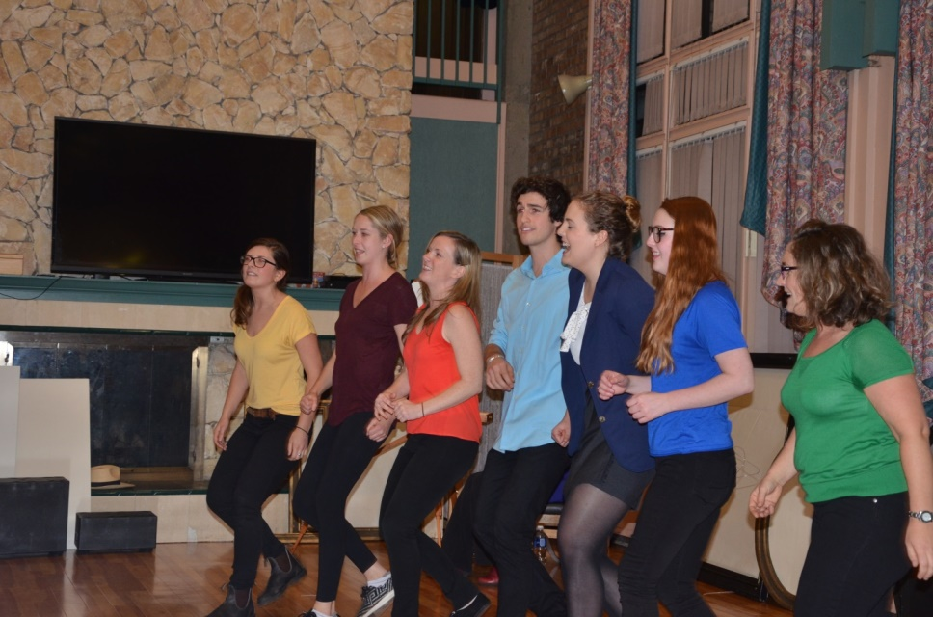
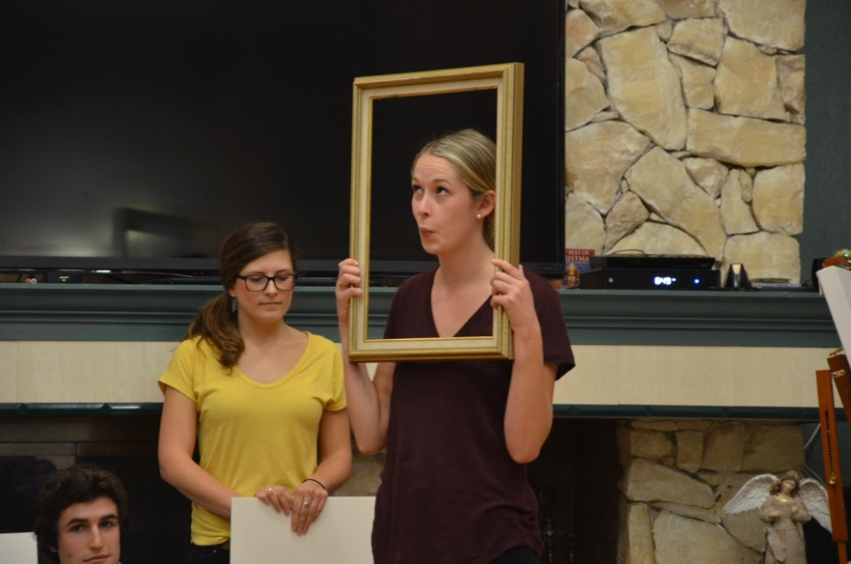
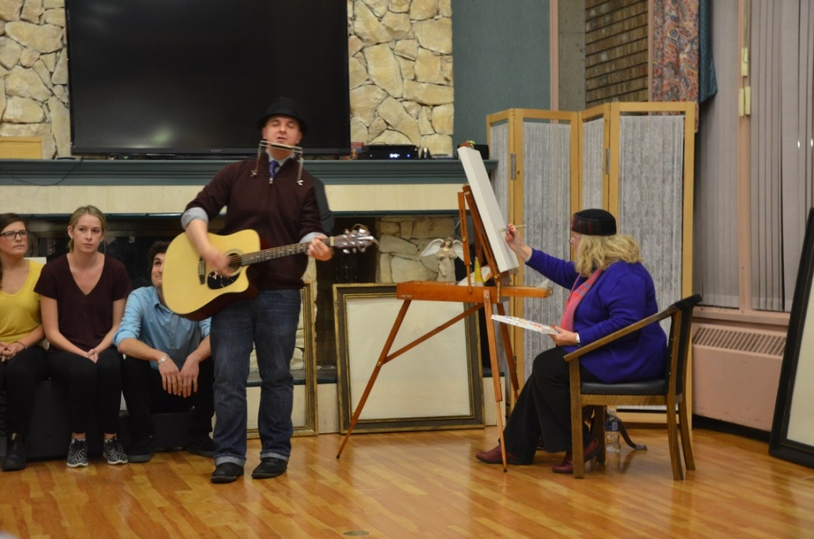

Slide 81
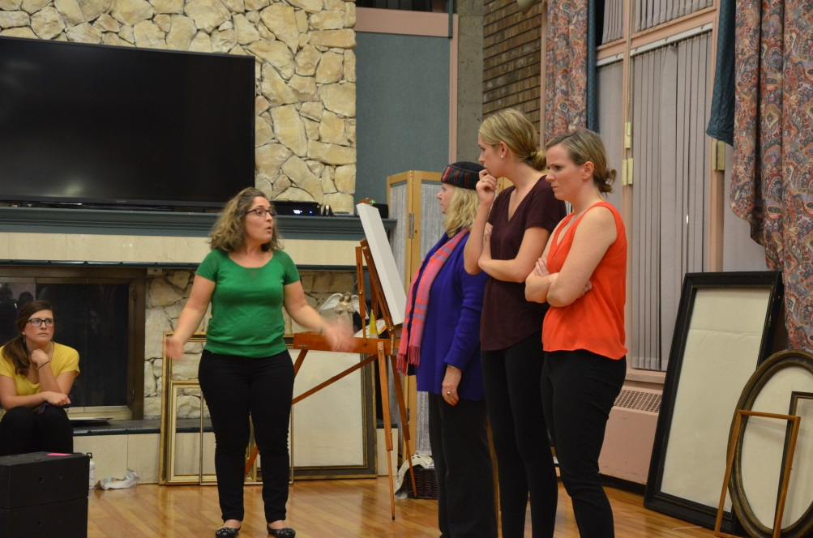
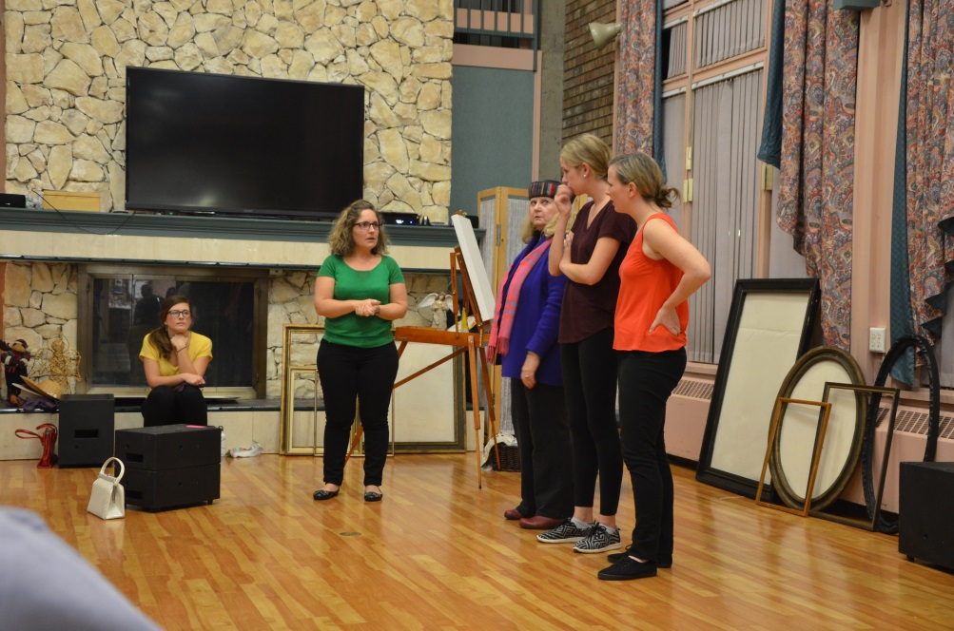

Slide 82
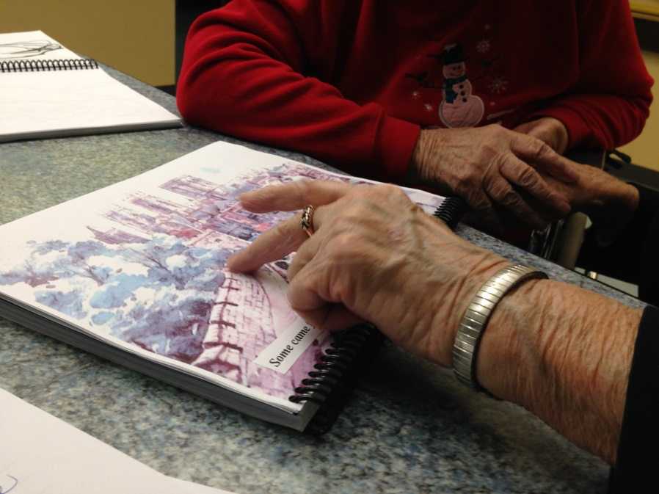
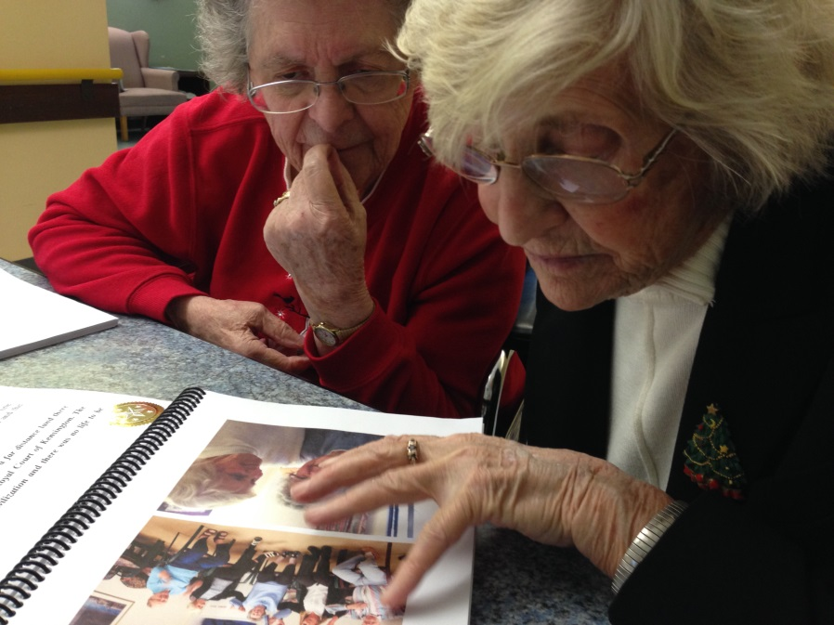
Post-Project Follow-Up
Care facility residents who participated in the study were given story booklets and certificates. A short documentary is in progress.
Giving the story booklets and certificates was a very moving experience.
Some residents, who did not recall participating, became flooded with stories and memories while reviewing the story booklet which contained key photos of their art work and family members.
Future projects need to integrate such photography.

Slide 83
Small-Groups Activity
Arts-in-Health Debate
Review the WHO health evident report and de-construct the report and other articles as to what the evidence is on the role of the arts in improving health and well-being.
Highlight key points you feel are most important.
Ask yourself where you fall on the continuum for arts in health care (100% in support… undecided… 100% against). Individually plan your argument why or why not.
Whole class: physical placement on continuum.
Class debate: Small groups prepare and present debate.

